Slide 1
RWD using Bootstrap

Slide 2
Version Control and Revision History
 | Name | Date
Prepared By | Ranjeet Kaur Bhachu | 30-Jul-2018
Reviewed By | Nisha Mendonsa | 30-Jul-2018
Approved By | Gauresh Gaitonde | 30-Jul-2018
Version No. | Date | Section Affected | Highlight of Changes
1.0.0 | 23-Mar-2017 | All | Original Version.
2.0.0 | 30-Jul-2018 | None | Annual Review 2018. No changes made.

Slide 3
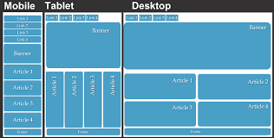

Responsive Web Design

Slide 4
Web Design Techniques
AWD (Adaptive Web Design)
Refers to the way of representing the same website by using separate URLs.
RWD (Responsive Web Design)
Helps designers to create device independent web content.
It follows the one-Web approach
Factors distinguishing the web pages
Screen size
Touch capability
Navigation
Content , Whitespaces
Images
Advertising

Slide 5
Difference between AWD and RWD
AWD | RWD
Uses separate URLs | One-Web approach i.e. single URL
AWD is server side. Server performs the tasks of detecting various devices, loading the appropriate template or CSS according to the device attributes and changing the layout as per the device screen. | RWD is client side. Web page is directly sent to the device’s browser. The browser then adjusts the appearance of the web page as per the CSS and the browser window of the device
Different versions of the web pages are created for varied set of devices. | New concepts such as media queries, flexible images and fluid grids are used.
Website gets loaded faster because different designs for different devices are available for on different domains and only the code/CSS is sent by the server rather than the entire responsive codebase. | The web page gets loaded slowly because the website is available on the same domain name and the device is loaded with the entire responsive codebase which may make it heavy.

Slide 6
Considerations for RWD
Design
Should look similar on all devices and environment.
Image size and screen layout
Images of different sizes so that they can be accommodated as per the screen size.
Mobile first
To optimize a website as per the device, it is advised to first present the content for small screens and then enhance it for the large screens.
Website Navigation
Navigation must be accomodable for different devices. Smartphones can have collpasible or expandable menu

Slide 7
Benefits of RWD
Minimal maintenance
Social sharing
Adaptation to new devices
Better viewing experience
Saves time and reduce cost of development and management
Ease of tracking the website

Slide 8
Limitations of RWD
Web page loading is slow as compared to AWD
The average development time of designing a Responsive Website is more than the time of designing a standard web site.
RWD cannot be implemented on existing websites.

Slide 9
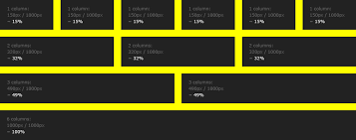
What is Responsive Web Design
RWD is simply a fluid grid.
Optimized for viewing experience.
RWD makes web page look good on all devices (desktop, tablets and phones)
It is using CSS and HTML to resize, hide, shrink, enlarge, or move the content to make it look good on any screen.
Responsive web design provides an optimal experience, easy reading and easy navigation with a minimum of resizing on different devices such as desktops, mobiles and tabs

Slide 10
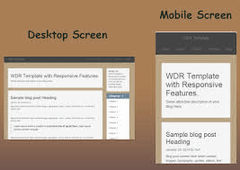
What is Responsive Web Design
Adaptive
Media queries to target various devices
Fluid
Flexible grids/ percentages rather than fixed
Responsive Design
Uses media queries and fluid grid to control the
scaling of the contents on various devices

Slide 11
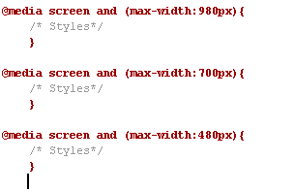
Responsive Web Design Core Components
Flexible Grids
Logical division of contents. Any number of columns/grid which scale to any width. Dimensions relative to the parent element.
Flexible Media (Images)
For accommodating the images on the screen using percentages so that images adjust to the parent container without cropping.
Media Queries (Styling capabilities)
Getting the characteristics of the target device, how website should be rendered on the device based on the type of the device.

Slide 12
Architecture of RWD
Content layer by using HTML.
Presentation layer that comprises CSS for styling.
Client side scripting layer that comprises JavaScript/JQuery

Slide 13
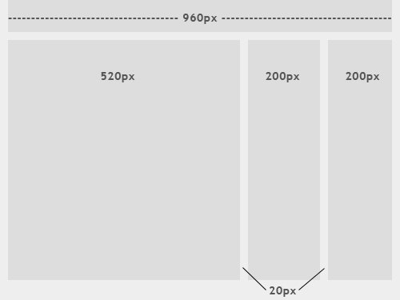
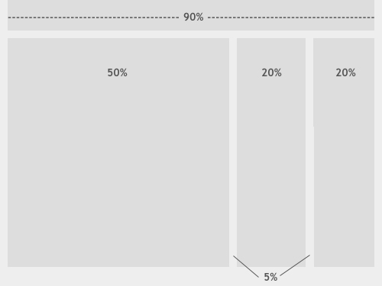
Fixed and Fluid Layouts
Fixed Layout
Has a wrapper that is a fixed width, and the components inside it have either percentage widths or fixed widths. The container element is set not to move irrespective of the screen resolution.
Fluid or Liquid Layout
The majority of the components inside have percentage widths and thus adjust to the users screen resolution.

Slide 14
Converting fixed to percentage
Percentage = target/context
E.g.: For header
Context = 940 px
Target = 850 px
Percentage = 850/940 *100 %
CSS Grid Framework or Grid Generator like
Tiny fluid grid
Variable grid system
Fluid grid calculators
Fluid Grid by Bootstrap
Header (90 %)
Section (70%)
Aside (20%)
Article (70%)
Footer (80%)

Slide 15
Fixed Vs. Fluid Web Page Design
FLUID | FIXED
Fluid web page design can be more user-friendly, because it adjusts to the user’s set up. | Fixed-width layouts are much easier to use and easier to customize in terms of design.
The amount of extra white space is similar between all browsers and screen resolutions, which can be more visually appealing. | Widths are the same for every browser, so there is less hassle with images, forms, video and other content that are fixed-width.
If designed well, a fluid layout can eliminate horizontal scroll bars in smaller screen resolutions. | There is no need for min-width or max-width, which isn’t supported by every browser anyway.
The designer has less control over what the user sees and may overlook problems because the layout looks fine on their specific screen resolution. | Smaller screen resolutions may require a horizontal scroll bar, depending the fixed layout’s width.
Images, video and other types of content with set widths may need to be set at multiple widths to accommodate different screen resolutions. | Fixed-width layouts generally have a lower overall score when it comes to usability.

Slide 16
Measurements for Responsiveness
percentages
em
viewport units (The viewport is the user's visible area of a web page.)
vw(viewport width): 1vw=1% of viewport width (1/100th viewport width)
vh(viewport height) : 1vw=1% of viewport height
vmin: 1vmin=the smallest of the values of 1vw or 1vh
vmax: 1vmax=the highest of the values of 1vw or 1vh

Slide 17

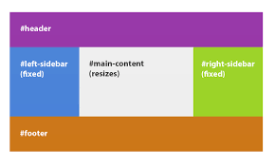
CSS3 Flexible Box
Use of flexbox ensures that elements behave predictably when the page layout must accommodate different screen sizes and different display devices.
Flexbox consists of flex containers and flex items.
Flex container: Is declared by setting the display property of an element to either flex (rendered as a block) or inline-flex (rendered as inline)
Flex item is a child of flex container. Text directly contained in a flex container is wrapped in an anonymous flex item.

Slide 18
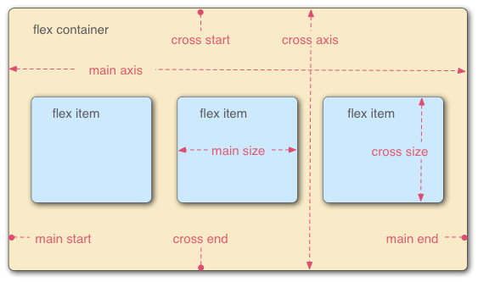
CSS3 Flexible Box contd…
Axes: Every flexible box layout follows two axis.
Main axis: Along which the flex items follow each other.
Cross axis: It is perpendicular to the main axis.
Directions: The main start/main end and cross start/cross end sides of the flex container describe the origin and terminus of the flow of flex items.
Lines: Flex items can be laid out on either a single line or on several lines according to the flex-wrap property which controls the direction of the cross axis and the direction in which new lines are stacked.
Dimensions: The flex items agnostic equivalents of height and width are main size and cross size, which respectively follow the main axis and cross axis of the flex container.

Slide 19
Browser Prefixes
Browser | Prefix
Chrome | -webkit-
Mozilla | -moz-
Opera | -o-
IE | -ms-
iOS | -webkit-
Android | -webkit-
Safari | -webkit-

Slide 20
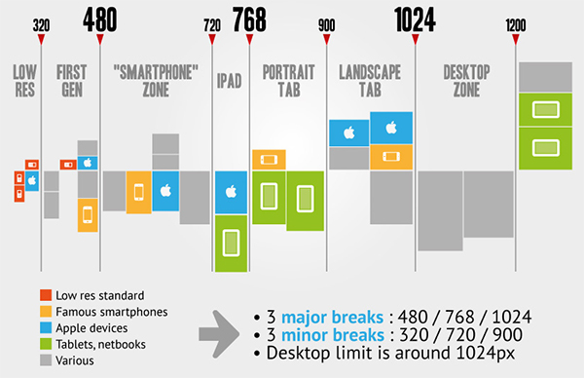
Media Queries Breakpoints

Slide 21
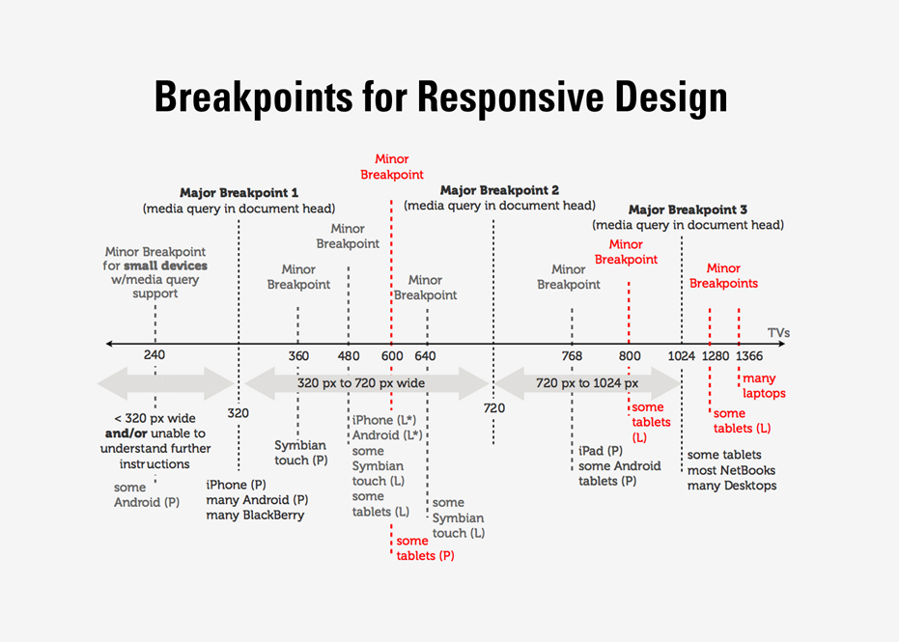

Slide 22
RWD using Bootstrap
Bootstrap is a powerful front-end framework (HTML, CSS and JS) for faster and easier responsive web development.
It is used to create responsive, interactive and feature rich websites with much less effort.
It includes HTML and CSS based design templates for common user interface components like Typography, Forms, Buttons, Tables, Navigations, Dropdowns, Alerts, Modals, Tabs, Accordion, Carousel and many other as well as optional JavaScript extensions.
Bootstrap comes equipped with HTML,CSS and JavaScript for various web and user interface components.

Slide 23
Advantages of Bootstrap
Embedded tools for creating flexible and responsive web layouts and interface components. Bootstrap Data API’s used for creating advanced interface components.
Advantages:
Saves time: Predefined design templates and classes
Consistent design: Design templates and styles through a central library.
Responsive features: Web pages for different devices and screen resolutions without any change in markup.
Easy to use
Compatible with browsers: Compatible with all modern browsers.
Open source

Slide 24
Bootstrap Files
Two versions of the file
Compiled Bootstrap
Compiled download contain compiled and minified version of CSS and JavaScript files as well as icons in font format for faster and easier web development. Increase the performance of your website and saves the precious bandwidth when you decided to move your site on production because of lesser HTTP request and download size since files are compiled and minified
Bootstrap source
Contains original source files for all CSS and JavaScript, along with a local copy of the docs.
https://maxcdn.bootstrapcdn.com/bootstrap/3.3.7/css/bootstrap.min.css
https://ajax.googleapis.com/ajax/libs/jquery/3.2.0/jquery.min.js
https://maxcdn.bootstrapcdn.com/bootstrap/3.3.7/js/bootstrap.min.js
https://ajax.googleapis.com/ajax/libs/jquery/3.2.0/jquery.min.js

Slide 25
Bootstrap Grid System
Bootstrap grid system provides the quick and easy way to create responsive website layouts.
Bootstrap 3 introduces the responsive mobile first fluid grid system that appropriately scales up to 12 columns as the device or viewport size increases.
Features Bootstrap Grid System | Extra small devices Phones (<768px) | Small devices Tablets (≥768px) | Medium devices Desktops (≥992px) | Large devices Desktops (≥1200px)
Max container width | None (auto) | 750px | 970px | 1170px
Grid behavior | Horizontal at all times | Collapsed to start, horizontal above breakpoints
Class prefix | .col-xs- | .col-sm- | .col-md- | .col-lg-
Max column width | Auto | ~62px | ~81px | ~97px
Gutter width | 15px on each side of a column (i.e. 30px)

Slide 26
Bootstrap Fluid Layout
.container-fluid class is used to create the fluid layouts in order to utilize the 100% width of the viewport.
The class .container-fluid simply applies the horizontal margin with the value auto and left and right padding of 15px on element to offset the left and right margin of -15px. (i.e. margin: 0 -15px;) used on the .row.

Slide 27
Bootstrap Responsive Layout
With the new Bootstrap 3 mobile first grid system creating the responsive and mobile friendly websites has become much easier.
Bootstrap 3 is responsive and mobile friendly from the start.
Its four tiers grids classes provides better control over the layout as well as how it will be rendered on different types of devices like cell phones, tablets, desktop and laptops, large screen devices etc.

Slide 28
Bootstrap Responsive Tables
With Bootstrap 3 you can also create responsive tables to enable horizontal scrolling on small devices (screen width under 768px).
To make any table responsive place the table inside a <div> element and apply the class .table-responsive on it.

Slide 29
Bootstrap List Groups
The list groups are very useful and flexible component for displaying lists of elements.
A list group is simply an unordered list with the class .list-group and list items having the class .list-group-item.
List group items can be hyperlinked. Icons and Badges can be added to the list group to make It more elegant.
Contextual classes can be added to the list group to apply extra emphasis on them.
Contextual States
list-group-item-success
list-group-item-info
list-group-item-warning
list-group-item-danger

Slide 30
Bootstrap Forms
Bootstrap provides three different types of form layouts:
Vertical form (default)
.form-control
Horizontal form
.form-horizontal to form element
.form-group to div element
.control-label to label element
Inline form
.form-inline to the form element

Slide 31
Bootstrap Input Groups and Button Groups
Input Groups are used for creating interactive form controls for textual input.
Button Groups are used to create series of buttons together in a single line through the button group component.

Slide 32
Bootstrap Images, Media Objects and Icons
Images can be made responsive by adding
.img-responsive to img tag
Bootstrap thumbnail is very useful for creating grids of images or videos , list of products, portfolios etc…
Bootstrap includes more than 250 Glyphicons which are available in font format for better usability and scalability. CSS color property can be applied to these icons.

Slide 33
Bootstrap Navigation and Panels
Navs:
Its an easy and quick way to create basic components like tabs and pills.
Navbar:
It is used for creating responsive navigation header for a website.
Different variations of the Navbar can be created:
Navbar with dropdown menus and search boxes.
Fixed position navbar.
Panels:
It is used to place the content in a box for better presentation.

Slide 34
Bootstrap Pagination and Breadcrumbs
Pagination is the process of organizing content by dividing it into separate pages.
It is used for displaying a limited number of results on search results pages, or showing a limited number of posts for each page.
A breadcrumb is a navigation scheme that indicates current page's location to the user within a website.
It is used for enhancing the accessibility of the websites having a large number of pages.
.breadcrumb class is used to create breadcrumbs.

Slide 35
Bootstrap Progress Bars and Wells
Progress bars can be used for showing the progress of a task or action to the users.
Simple progress bar
Stripped progress bar
Stacked progress bar
Progress bars with emphasis classes
Stripped progress bars with emphasis classes
Well component provides a quick way to apply a simple inset effect to an element. It is useful to place some content inside a box to make it look different from rest of the contents.

